Slide 1
CSCI 7000 - AI for Science
Week 5: Beyond citations: full-text natural language processing, key phrase generation, embeddings
Daniel Acuna
Computer Science Department
University of Colorado at Boulder

Slide 2
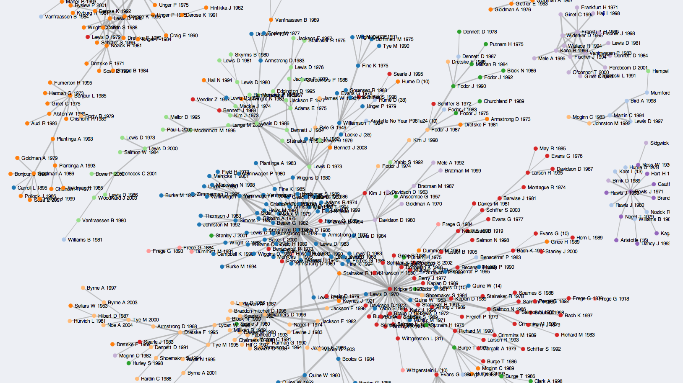

Slide 3


Slide 4
Natural language processing
“Natural language processing is a subfield of linguistics, computer science, and artificial intelligence concerned with the interactions between computers and human language, in particular how to program computers to process and analyze large amounts of natural language data” https://en.wikipedia.org/wiki/Natural_language_processing

Slide 5
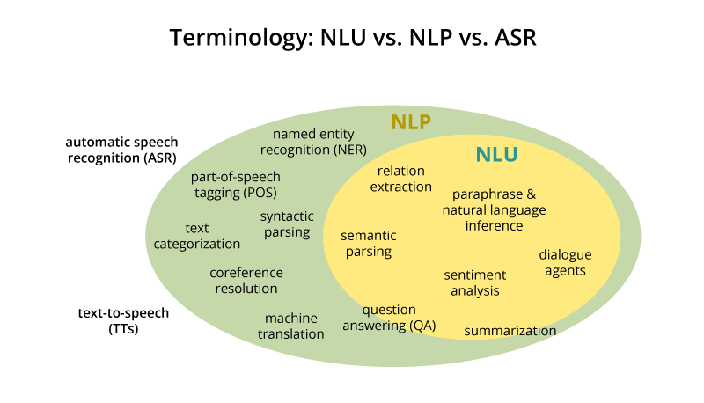

Slide 6
Tasks in science
Text representation (TF-IDF, Latent Semantic Analysis, Latent Dirichlet Allocation)
Text embeddings (word2vec, embeddings)
Extracting keywords from text
Citation-enriched text representation: Adapted transformers

Slide 7
Latent Dirichlet Allocation (LDA)
LDA is a very popular language modeling technique
Each document (x) is represented as a bag-of-words (*)
U represents the distribution of topics of each document
V represents the distribution of words per topic
m
p
X
U
m
n
=
V
p
X
* The probabilistic generation of a document is more complicated than this

Slide 8
Latent Dirichlet Allocation (LDA)
From: Probabilistic Topic Models By David M. Blei, Communications of the ACM, Vol. 55 No. 4

Slide 9
LDA: discovering topics in a text corpus
Why map knowledge?
Quickly grasp important themes in a new field
Synthesize content of an existing field
Discover targets for funding and research
Understand a corpus of text

Slide 10
1. A generative model for documents
2. Discovering topics with Gibbs sampling
3. Results
Topics and classes
Topic dynamics

Slide 11
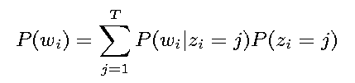
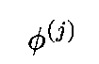
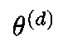
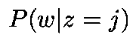
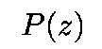
A generative model for documents
Each document a mixture of topics
Each word chosen from a single topic
from parameters
from parameters
(Blei, Ng, & Jordan, 2003)

Slide 12
A generative model for documents
w P(w|z = 1) = φ ⁽¹⁾
w P(w|z = 2) = φ ⁽²⁾
HEART 0.2
LOVE 0.2
SOUL 0.2
TEARS 0.2
JOY 0.2
SCIENTIFIC 0.0
KNOWLEDGE 0.0
WORK 0.0
RESEARCH 0.0
MATHEMATICS 0.0
HEART 0.0
LOVE 0.0
SOUL 0.0
TEARS 0.0
JOY 0.0
SCIENTIFIC 0.2
KNOWLEDGE 0.2
WORK 0.2
RESEARCH 0.2
MATHEMATICS 0.2
topic 1
topic 2

Slide 13
Choose mixture weights for each document, generate “bag of words”
θ = {P(z = 1), P(z = 2)}
{0, 1}
{0.25, 0.75}
{0.5, 0.5}
{0.75, 0.25}
{1, 0}
MATHEMATICS KNOWLEDGE RESEARCH WORK MATHEMATICS
RESEARCH WORK SCIENTIFIC MATHEMATICS WORK
SCIENTIFIC KNOWLEDGE MATHEMATICS SCIENTIFIC
HEART LOVE TEARS KNOWLEDGE HEART
MATHEMATICS HEART RESEARCH LOVE MATHEMATICS
WORK TEARS SOUL KNOWLEDGE HEART
WORK JOY SOUL TEARS MATHEMATICS
TEARS LOVE LOVE LOVE SOUL
TEARS LOVE JOY SOUL LOVE TEARS SOUL SOUL TEARS JOY

Slide 14
A generative model for documents
θ
z
z
z
w
w
w
Called Latent Dirichlet Allocation (LDA)
Introduced by Blei, Ng, and Jordan (2003), reinterpretation of PLSI (Hofmann, 2001)

Slide 15
Dirichlet Distributions
In the LDA model, we would like to say that the topic mixture proportions for each document are drawn from some distribution.
So, we want to put a distribution on multinomials. That is, k-tuples of non-negative numbers that sum to one.
The space is of all of these multinomials has a nice geometric interpretation as a (k-1)-simplex, which is just a generalization of a triangle to (k-1) dimensions.
Criteria for selecting our prior:
It needs to be defined for a (k-1)-simplex.
Algebraically speaking, we would like it to play nice with the multinomial distribution.

Slide 16
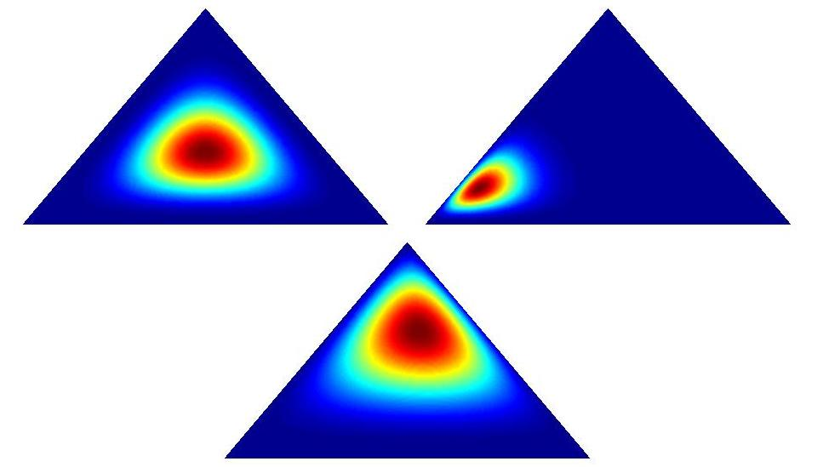
Dirichlet Examples

Slide 17
Topic Model: Geometric Representation
Notes:
Vocabulary of W words => W-dimensional space, axis = prob of observing a given word
W-1 dimensional simplex represents all prob distributions over words
Doc=point on simplex; topic=point on simplex; doc=convex combination of topics;
Dirichlet’s prior on topic-word distribution beta=pulls topics away from corners;
Dirichlet’s prior on doc-topic distributions alpha=forces on convex combinations;
If T<<W(word-types), topics span a low-dimensionality subsimplex & projection of doc onto low-dim can be thought of as dim reduction.

Slide 18
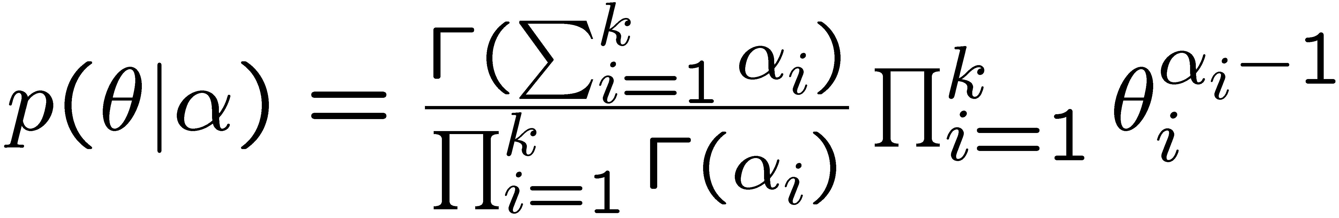
Dirichlet Distributions
Useful Facts:
This distribution is defined over a (k-1)-simplex. That is, it takes k non-negative arguments which sum to one. Consequently it is a natural distribution to use over multinomial distributions.
In fact, the Dirichlet distribution is the conjugate prior to the multinomial distribution. (This means that if our likelihood is multinomial with a Dirichlet prior, then the posterior is also Dirichlet!)
The Dirichlet parameter α_{i} can be thought of as a prior count of the i^{th} class.
Notes:
you need to first motivate why we need a dirichlet distribution, i.e., we need distribution over a mixture of classes, which is distribution over weights that add up to one.
you can then show the picture in the next slide, and then show this slide last.

Slide 19
The LDA Model
α
θ
θ
θ
z₁
z₂
z₃
z₄
z₁
z₂
z₃
z₄
z₁
z₂
z₃
z₄
w₁
w₂
w₃
w₄
w₁
w₂
w₃
w₄
w₁
w₂
w₃
w₄
For each document,
Choose θ~Dirichlet(α)
For each of the N words wn:
Choose a topic z_{n}» Multinomial(θ)
Choose a word w_{n} from p(w_{n}|z_{n},β), a multinomial probability conditioned on the topic z_{n}.
β

Slide 20
The LDA Model
β
φ K
α
z
w N
M
θ
For each document,
Choose θ» Dirichlet(α)
For each of the N words w_{n}:
Choose a topic z_{n}» Multinomial(θ)
Choose a word w_{n} from p(w_{n}|z_{n},β), a multinomial probability conditioned on the topic z_{n}.
Notes:
before this slide and the previous, say why the previous model is not good enough.
say that you need to be bayesian about the mixture between classes
show an unrolled LDA model, and explain why it’s different than the previous models
I like the generative model description. use it in the previous models, it will make the differences more clear.

Slide 21
Inference
β
φ K
α
z
w N
M
θ
The inference problem in LDA is to compute the posterior of the hidden variables given a document and corpus parameters α and β. That is, compute p(θ,φ,z|w,α,β).
Unfortunately, exact inference is intractable, so we turn to alternatives…
Notes:
add a slide between this one and the previous showing what the inference task is in the context of an example.
explain that inference is hard in this graphical model, this is very hard to see in this picture.

Slide 22
The LDA equations
β
φ K
α
z
w N
M
θ

Slide 23
Corpus preprocessing
Used all D = 28,154 abstracts from 1991-2001
Used any word occurring in at least five abstracts, not on “stop” list (W = 20,551)
Segmentation by any delimiting character, total of n = 3,026,970 word tokens in corpus
Also, PNAS class designations for 2001
(thanks to Kevin Boyack)

Slide 24
Topics and classes
PNAS authors provide class designations
major: Biological, Physical, Social Sciences
minor: 33 separate disciplines*
Find topics diagnostic of classes
validate “reality” of classes
show topics pick out meaningful structure (classes, and the the relations between them)

Slide 25
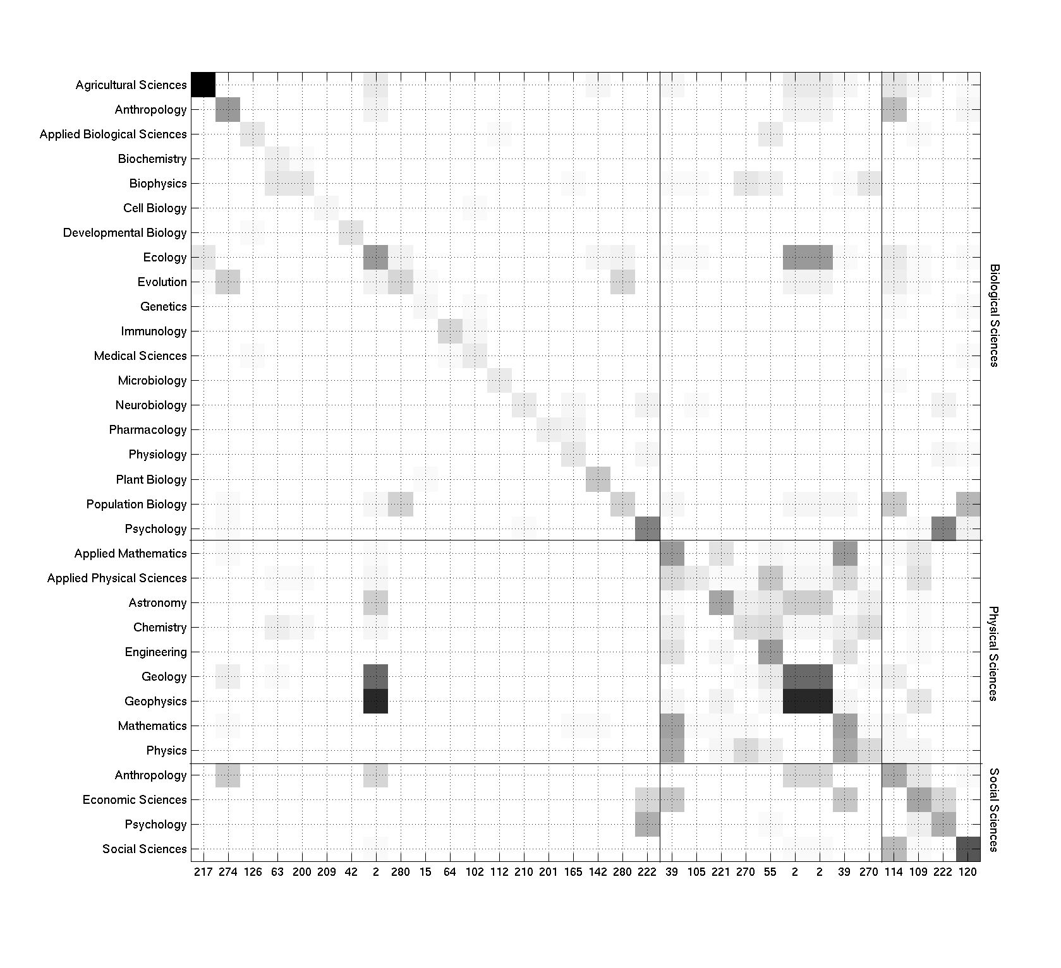

Slide 26
210
SYNAPTIC
NEURONS
POSTSYNAPTIC
HIPPOCAMPAL
SYNAPSES
LTP
PRESYNAPTIC
TRANSMISSION
POTENTIATION
PLASTICITY
EXCITATORY
RELEASE
DENDRITIC
PYRAMIDAL
HIPPOCAMPUS
DENDRITES
CA1
STIMULATION
TERMINALS
SYNAPSE

Slide 27
201
RESISTANCE
RESISTANT
DRUG
DRUGS
SENSITIVE
MDR
MULTIDRUG
SUSCEPTIBLE
SELECTED
GLYCOPROTEIN
SENSITIVITY
PGP
AGENTS
CONFERS
MDR1
CYTOTOXIC
CONFERRED
CHEMOTHERAPEUTIC
EFFLUX
INCREASED

Slide 28
280
SPECIES
SELECTION
EVOLUTION
GENETIC
POPULATIONS
POPULATION
VARIATION
NATURAL
EVOLUTIONARY
FITNESS
ADAPTIVE
RATES
THEORY
TRAITS
DIVERSITY
EXPECTED
NEUTRAL
EVOLVED
COMPETITION
HISTORY

Slide 29
222
CORTEX
BRAIN
SUBJECTS
TASK
AREAS
REGIONS
FUNCTIONAL
LEFT
MEMORY
TEMPORAL
IMAGING
PREFRONTAL
CEREBRAL
TASKS
FRONTAL
AREA
TOMOGRAPHY
EMISSION
POSITRON
CORTICAL

Slide 30
2
SPECIES
GLOBAL
CLIMATE
CO2
WATER
ENVIRONMENTAL
YEARS
MARINE
CARBON
DIVERSITY
OCEAN
EXTINCTION
TERRESTRIAL
COMMUNITY
ABUNDANCE
EARTH
ECOLOGICAL
CHANGE
TIME
ECOSYSTEM

Slide 31
39
THEORY
TIME
SPACE
GIVEN
PROBLEM
SHAPE
SIMPLE
DIMENSIONAL
PAPER
NUMBER
CASE
LOCAL
TERMS
SYMMETRY
RANDOM
EQUATION
CLASSICAL
COMPLEXITY
NUMERICAL
PROPERTIES

Slide 32
Mapping science
Topics provide dimensionality reduction
Some applications require visualization (and even lower dimensionality)
Low-dimensional representation from methods for analysis of compositional data

Slide 33
Problems with LDA
It does not scale well
Priors tend to make strong assumptions about the data distribution
Hard to interpret or validate

Slide 34
New methods
Most new methods for text analysis are based on neural networks
Therefore, we cannot avoid reviewing the principles of ANN

Slide 35
A bit of neuroscience
Deep learning takes loose inspiration from how the brain works
At an architectural level, the brain works by combining specialized neurons in hierarchies
E.g., the visual system is organized into several areas (around 8)

Slide 36
A bit of neuroscience

Slide 37
Higher levels are more abstract

Slide 38
A bit of neuroscience (2)
The brain has relatively ”simple” processing units: neurons
Credit: http://www.intechopen.com/source/html/39067/media/image1.png

Slide 40
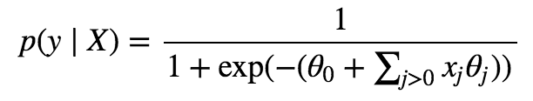
Features
A model for the probability of an action potential!

Slide 41
Of course reality is a lot more complicated

Slide 42
Perceptron

Slide 43
Modern artificial neurons

Slide 44
Modern artificial neurons

Slide 45
Artificial neural network

Slide 46
Input and output parameters

Slide 47
ANN can have arbitrary configurarions

Slide 48
Deep neural networks
ANN with a "large" number of layers

Slide 49
Fully-connected layers

Slide 50
Layers can be more than 1-D

Slide 51
A trivial example: no activation
Activity: show that a "linear" neural network does not really need layers

Slide 52
Activation functions
Allow to represent complex relationships between inputs and outputs
Choice depends on derivatives and other properties such as numerical stability
This will become important during training

Slide 53
Sigmoid

Slide 54
Activity
Run Tensorflow playground with different activations
https://playground.tensorflow.org/

Slide 55
How do we “train” neural networks?
From Wikipedia: In machine learning, backpropagation (backprop, BP) is a widely used algorithm for training feedforward neural networks. Generalizations of backpropagation exist for other artificial neural networks (ANNs), and for functions generally. These classes of algorithms are all referred to generically as "backpropagation". In fitting a neural network, backpropagation computes the gradient of the loss function with respect to the weights of the network for a single input–output example, and does so efficiently, unlike a naive direct computation of the gradient with respect to each weight individually.

Slide 56
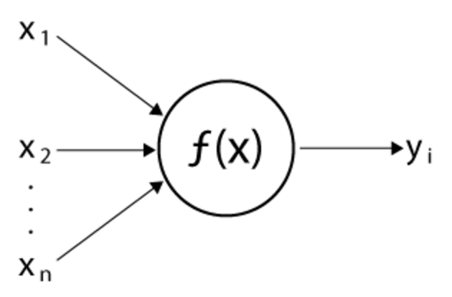
The general idea of artificial neural networks
Simple processing units with linear or non-linear functions f

Slide 57
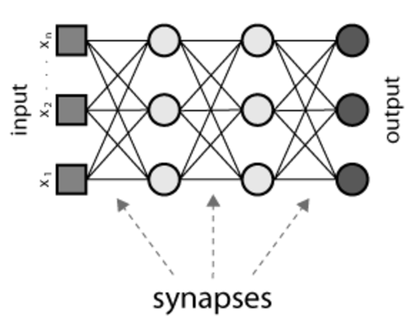
The general idea of artificial neural networks (2)
Multiple units belong to layers and those layers are interconnected to other layers

Slide 58
A highly non-linear function
The output now depends on nested functions: $y=f_{3}(f_{2}\left(f_{1}(x\right)+b_{0})+b_{1})+b_{2}$
Nested non-linearities

Slide 59
Advantages and disadvantages of ANN
Pros:
Can fit complex non-linear relationships
Easy to try different types of layers
Inspired by a very effective machine (the brain!)
Cons:
Many parameters
Easy to overfit
Needs lots of training data
Takes a long time to fit
The use of brain research is really minimal

Slide 60
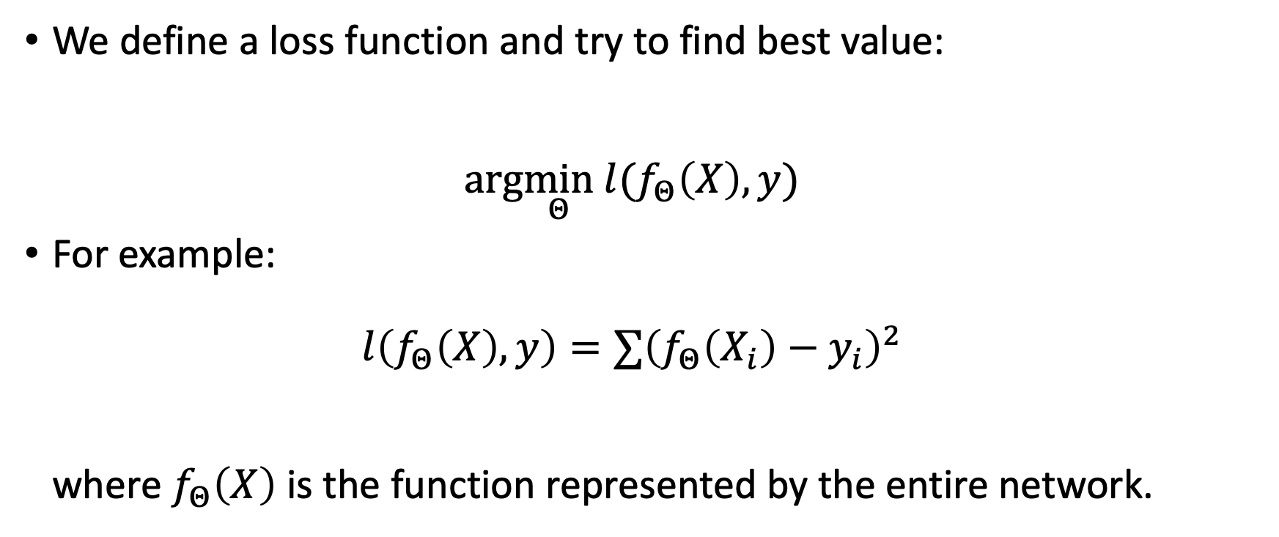
How to train a neural network?
We define a loss function and try to find best value: $arg\min_{Θ} l(f_{Θ}\left(X\right),y)$
For example: $l\left(f_{Θ}\left(X\right),y\right)=∑{\left(f_{Θ}\left(X_{i}\right)−y_{i}\right)}^{2}$ where $f_{Θ}\left(X\right)$ is the function represented by the entire network.

Slide 61
Optimizing the loss function
There is no close solution to the loss function $arg\min_{Θ} l(f_{Θ}\left(X\right),y)$
In all but the trivial cases, the loss function is non-convex (hard to optimize)
A very effective approach to perform stochastic gradient descent

Slide 62
Gradient descent
Gradient descent is a simple approach to iteratively minimize a loss function
Intuitively, we want to follow the negative of the gradient to find the minimum of a loss function. $Θ_{t+1} =Θ_{t}−η ∇l(f_{Θ}\left(X\right),y)$

Slide 63
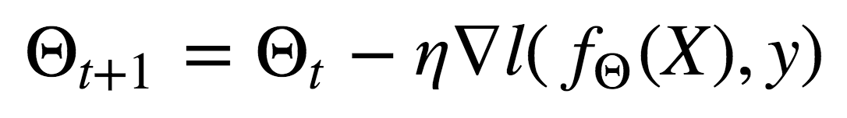
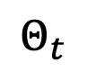

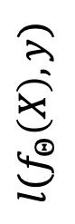
Gradient descent: example (2)
$$Θ_{t+1}=Θ_{t}−η ∇l(f_{Θ}\left(X\right),y)$$
$$l(f_{Θ}\left(X\right),y)$$
$$Θ_{t}$$
$$Θ$$
Current solution

Slide 64
Gradient descent: example (2)
$$Θ_{t+1}=Θ_{t}−η ∇l(f_{Θ}\left(X\right),y)$$
Gradient is negative
$$l(f_{Θ}\left(X\right),y)$$
$$Θ_{t}$$
$$Θ$$
Current solution

Slide 65
Gradient descent: example (3)
$$Θ_{t+1}=Θ_{t}−η ∇l(f_{Θ}\left(X\right),y)$$
$$l(f_{Θ}\left(X\right),y)$$
$$Θ_{t}$$
$$Θ$$
Gradient is negative in loss/feature units
Current solution

Slide 66
Gradient descent: example (4)
$$Θ_{t+1}=Θ_{t}−η ∇l(f_{Θ}\left(X\right),y)$$
$$l(f_{Θ}\left(X\right),y)$$
$$Θ_{t}$$
$$Θ$$
We need to rescale by a learning rate
Current solution

Slide 67
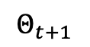
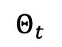
Gradient descent: example (5)
$$Θ_{t+1}=Θ_{t}−η ∇l(f_{Θ}\left(X\right),y)$$
$$l(f_{Θ}\left(X\right),y)$$
$$Θ_{t}$$
$$Θ_{t+1}$$
$$Θ$$
New solution for next iteration

Slide 68
Worked out example

Slide 69
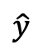
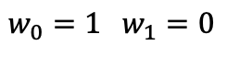
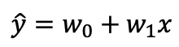
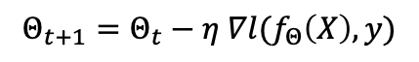
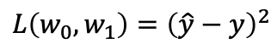
Worked out example
w₁
Gradient descent
x
+
$$\hat{y}$$
$$\hat{y}=w_{0}+w_{1}x$$
$$Θ_{t+1}=Θ_{t}−η ∇l(f_{Θ}\left(X\right),y)$$
w₀
$$L\left(w_{0},w_{1}\right)={\left(\hat{y}−y\right)}^{2}$$
bias = 1
(x₁, y₁) = (2, 2)
Iteration 0
$$w_{0}=1 w_{1}=0$$
(x₂, y₂) = (0, 0)

Slide 70
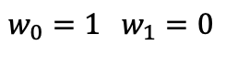
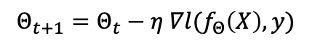
Worked out example
w₁
Gradient descent
x
+
$$\hat{y}$$
$$\hat{y}=w_{0}+w_{1}x$$
$$Θ_{t+1}=Θ_{t}−η ∇l(f_{Θ}\left(X\right),y)$$
w₀
$$L\left(w_{0},w_{1}\right)={\left(\hat{y}−y\right)}^{2}$$
bias = 1
Iteration 0
$$w_{0}=1 w_{1}=0$$
(x₁, y₁) = (2, 2)
$$Θ_{t+1}=Θ_{t}−η ∇l(f_{Θ}\left(X\right),y)$$
Iteration 1 with (x1, y1)
(x₂, y₂) = (0, 0)
Iteration 2 with (x2, y2)

Slide 71
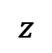
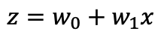
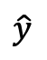
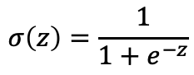
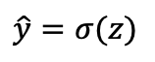
Worked out example: activation
w₁
$$σ\left(z\right)=\frac{1}{1+e^{−z}}$$
Gradient descent
$$z$$
x
+
σ
$$\hat{y}$$
$$z=w_{0}+w_{1}x$$
$$Θ_{t+1}=Θ_{t}−η ∇l(f_{Θ}\left(X\right),y)$$
$$\hat{y}=σ(z)$$
w₀
$$L\left(w_{0},w_{1}\right)={\left(\hat{y}−y\right)}^{2}$$
bias = 1

Slide 72
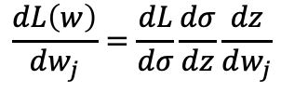
Worked out example : activation
w₁
$$σ\left(z\right)=\frac{1}{1+e^{−z}}$$
Gradient descent
$$z$$
x
+
σ
$$\hat{y}$$
$$z=w_{0}+w_{1}x$$
$$Θ_{t+1}=Θ_{t}−η ∇l(f_{Θ}\left(X\right),y)$$
$$\hat{y}=σ(z)$$
w₀
$$L\left(w_{0},w_{1}\right)={\left(\hat{y}−y\right)}^{2}$$
bias = 1
Chain rule of calculus
$$\frac{dL\left(w\right)}{dw_{j}}=\frac{dL}{dσ}\frac{dσ}{dz}\frac{dz}{dw_{j}}$$

Slide 73
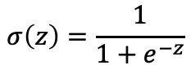
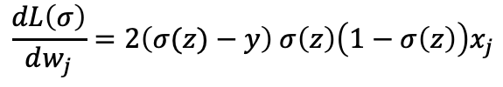
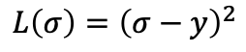
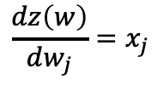
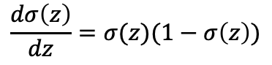
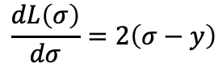
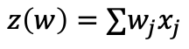
Worked out example : activation
w₁
$$σ\left(z\right)=\frac{1}{1+e^{−z}}$$
Gradient descent
$$z$$
x
+
σ
$$\hat{y}$$
$$z=w_{0}+w_{1}x$$
$$Θ_{t+1}=Θ_{t}−η ∇l(f_{Θ}\left(X\right),y)$$
$$\hat{y}=σ(z)$$
w₀
$$L\left(w_{0},w_{1}\right)={\left(\hat{y}−y\right)}^{2}$$
bias = 1
Chain rule of calculus
$$L\left(σ\right)={\left(σ−y\right)}^{2}$$
$$\frac{dL\left(σ\right)}{dσ}=2\left(σ−y\right)$$
$$\frac{dL\left(w\right)}{dw_{j}}=\frac{dL}{dσ}\frac{dσ}{dz}\frac{dz}{dw_{j}}$$
$$σ\left(z\right)=\frac{1}{1+e^{−z}}$$
$$\frac{dσ\left(z\right)}{dz}=σ(z)(1−σ\left(z\right))$$
$$z\left(w\right)=∑w_{j}x_{j}$$
$$\frac{dz\left(w\right)}{dw_{j}}=x_{j}$$
$$\frac{dL\left(σ\right)}{dw_{j}}=2\left(σ(z)−y\right) σ\left(z\right)\left(1−σ\left(z\right)\right)x_{j}$$

Slide 74
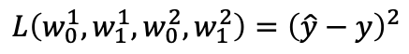
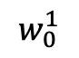
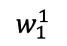
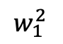
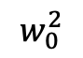
Worked out example : two “layers”
a: activation of a neuron
Gradient descent
$$Θ_{t+1}=Θ_{t}−η ∇l(f_{Θ}\left(X\right),y)$$
$$w_{1}^{1}$$
$$w_{1}^{2}$$
z¹
a¹
z²
x
+
σ
+
σ
$$\hat{y}$$
$$L\left(w_{0}^{1},w_{1}^{1},w_{0}^{2},w_{1}^{2}\right)={\left(\hat{y}−y\right)}^{2}$$
$$w_{0}^{1}$$
$$w_{0}^{2}$$
bias = 1
bias = 1

Slide 75
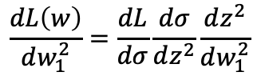
Worked out example : two “layers”
a: activation of a neuron
Gradient descent
$$Θ_{t+1}=Θ_{t}−η ∇l(f_{Θ}\left(X\right),y)$$
$$w_{1}^{1}$$
$$w_{1}^{2}$$
z¹
a¹
z²
x
+
σ
+
σ
$$\hat{y}$$
$$L\left(w_{0}^{1},w_{1}^{1},w_{0}^{2},w_{1}^{2}\right)={\left(\hat{y}−y\right)}^{2}$$
$$w_{0}^{1}$$
$$w_{0}^{2}$$
bias = 1
bias = 1
$$\frac{dL\left(w\right)}{dw_{1}^{2}}=\frac{dL}{dσ}\frac{dσ}{dz^{2}}\frac{dz^{2}}{dw_{1}^{2}}$$

Slide 76
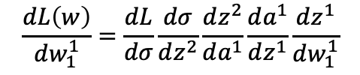
Worked out example : two “layers”
a: activation of a neuron
Gradient descent
$$Θ_{t+1}=Θ_{t}−η ∇l(f_{Θ}\left(X\right),y)$$
$$w_{1}^{1}$$
$$w_{1}^{2}$$
z¹
a¹
z²
x
+
σ
+
σ
$$\hat{y}$$
$$L\left(w_{0}^{1},w_{1}^{1},w_{0}^{2},w_{1}^{2}\right)={\left(\hat{y}−y\right)}^{2}$$
$$w_{0}^{1}$$
$$w_{0}^{2}$$
bias = 1
bias = 1
$$\frac{dL\left(w\right)}{dw_{1}^{2}}=\frac{dL}{dσ}\frac{dσ}{dz^{2}}\frac{dz^{2}}{dw_{1}^{2}}$$
$$\frac{dL\left(w\right)}{dw_{1}^{1}}=\frac{dL}{dσ}\frac{dσ}{dz^{2}}\frac{dz^{2}}{da^{1}}\frac{da^{1}}{dz^{1}}\frac{dz^{1}}{dw_{1}^{1}}$$

Slide 77
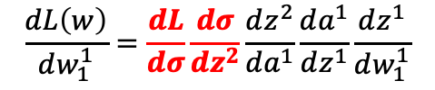
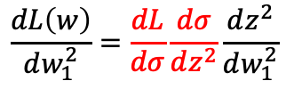
Worked out example : two “layers”
a: activation of a neuron
Gradient descent
$$Θ_{t+1}=Θ_{t}−η ∇l(f_{Θ}\left(X\right),y)$$
$$w_{1}^{1}$$
$$w_{1}^{2}$$
z¹
a¹
z²
x
+
σ
+
σ
$$\hat{y}$$
$$L\left(w_{0}^{1},w_{1}^{1},w_{0}^{2},w_{1}^{2}\right)={\left(\hat{y}−y\right)}^{2}$$
$$w_{0}^{1}$$
$$w_{0}^{2}$$
bias = 1
bias = 1
$$\frac{dL\left(w\right)}{dw_{1}^{2}}=\frac{dL}{dσ}\frac{dσ}{dz^{2}}\frac{dz^{2}}{dw_{1}^{2}}$$
$$\frac{dL\left(w\right)}{dw_{1}^{1}}=\frac{dL}{dσ}\frac{dσ}{dz^{2}}\frac{dz^{2}}{da^{1}}\frac{da^{1}}{dz^{1}}\frac{dz^{1}}{dw_{1}^{1}}$$
$$\frac{dL\left(w\right)}{dw_{1}^{1}}=\frac{dL}{dσ}\frac{dσ}{dz^{2}}\frac{dz^{2}}{da^{1}}\frac{da^{1}}{dz^{1}}\frac{dz^{1}}{dw_{1}^{1}}$$

Slide 78
Backpropagation
The previous example is the basis of stochastic gradient descent for several layers
Backpropagation is a general algorithm that exploits the structure of the chain rule when applied to layers
To understand backpropagation, we need to understand middle layers
Layer L - 2
Layer L - 1
Layer L
y₁
y₂
…
…

Slide 79
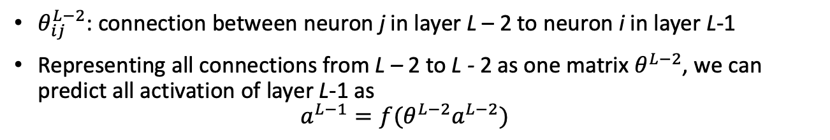
Backpropagation (2)
$θ_{ij}^{L−2}$: connection between neuron j in layer L – 2 to neuron i in layer L-1
Representing all connections from L – 2 to L - 2 as one matrix $θ^{L−2}$, we can predict all activation of layer L-1 as $a^{L−1}=f(θ^{L−2}a^{L−2})$
Layer L - 2
Layer L - 1
Layer L
y₁
y₂
…
…

Slide 80
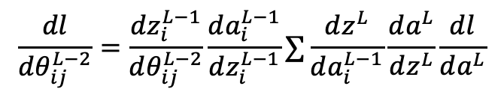
Backpropagation (3)
Then the gradient of a connection $θ_{ij}^{L−2}$ with respect to the loss function will be
$$\frac{dl}{dθ_{ij}^{L−2}}=\frac{dz_{i}^{L−1}}{dθ_{ij}^{L−2}}\frac{da_{i}^{L−1}}{dz_{i}^{L−1}}∑\frac{dz^{L}}{da_{i}^{L−1}}\frac{da^{L}}{dz^{L}}\frac{dl}{da^{L}}$$
Layer L - 2
Layer L - 1
Layer L
y₁
y₂
…
…

Slide 81

Backpropagation (4)
Then the gradient of a connection $θ_{jk}^{L−3}$ with respect to the loss function will be
$$\frac{dl}{dθ_{jk}^{L−3}}=\frac{dz_{j}^{L−2}}{dθ_{k}^{L−3}}\frac{da_{j}^{L−2}}{dz_{j}^{L−2}}∑\frac{dz_{i}^{L−1}}{da_{j}^{L−2}}\frac{da_{i}^{L−1}}{dz_{i}^{L−1}}∑\frac{dz^{L}}{da_{i}^{L−1}}\frac{da^{L}}{dz^{L}}\frac{dl}{da^{L}}$$
Layer L - 3
Layer L - 2
Layer L - 1
Layer L
y₁
y₂
…
…

Slide 82


Backpropagation (5)
The same structure gets repeated during the chain rule:
Therefore, we can backpropagate the gradient of the loss function
Notice also, that we reuse a and z multiple times, therefore we could precompute them
Therefore, we could forward propagate a and z and backpropagate the errors.
$$\frac{dl}{dθ_{ij}^{L−2}}=\frac{dz_{i}^{L−1}}{dθ_{ij}^{L−2}}\frac{da_{i}^{L−1}}{dz_{i}^{L−1}}∑\frac{dz^{L}}{da_{i}^{L−1}}\frac{da^{L}}{dz^{L}}\frac{dl}{da^{L}}$$
$$\frac{dl}{dθ_{jk}^{L−3}}=\frac{dz_{j}^{L−2}}{dθ_{k}^{L−3}}\frac{da_{j}^{L−2}}{dz_{j}^{L−2}}∑\frac{dz_{i}^{L−1}}{da_{j}^{L−2}}\frac{da_{i}^{L−1}}{dz_{i}^{L−1}}∑\frac{dz^{L}}{da_{i}^{L−1}}\frac{da^{L}}{dz^{L}}\frac{dl}{da^{L}}$$

Slide 83

Backpropagation algorithm
Forward propagation
From layer 1 thought L
Compute a and z
Backpropagation
Define $δ_{i}^{L}=a^{L}−y$ (gradient of loss function)
From layer L – 1 to 1
Define $δ_{j}^{L−1}=a_{j}^{L−1}(1−a_{j}^{L−1}) ∑θ_{ij}^{L−1}δ_{i}^{L}$
The gradients will be computed as follows
$$\frac{dl}{dθ_{ij}^{k}}=a_{j}^{k}a_{i}^{k+1}\left(1−a_{i}^{k+1}\right)∑{a_{i}^{k+1}δ}_{i}^{k+1}$$

Slide 84
LSTM with words
56
This problem was based on a simple encoding of sequences of characters
But characters is too low resolution to capture the meaning of words
We perhaps would like inputs to be the words
Size of inputs?
Input size
Sequence length

Slide 85
LSTM with words
This problem was based on a simple encoding of sequences of characters
But characters is too low resolution to capture the meaning of words
We perhaps would like inputs to be the words
Size of inputs?
Input size
Parameters: 4 sets of
- W matrix: (input + 1)*(memory size)
- U matrix: (memory size)*(memory size)
The "+1" is due to bias term
Sequence length
Input can be quite large! (Maximum sequence length x number of words)

Slide 86
LSTM with words
Also, there is no relationship between words
Words encoded as one-hot encoding
The input representation x doesn't have correlations

Slide 87
LSTM with words
Queen | 1 | 0 | 0 | 0
Woman | 0 | 1 | 0 | 0
King | 0 | 0 | 1 | 0
Man | 0 | 0 | 0 | 1
distance(w1, w2) = 0 by definition

Slide 88
Embeddings
When some object X is said to be embedded in another object Y, the embedding is given by some injective and structure-preserving map f: X → Y
The precise meaning of "structure-preserving" depends on the kind of mathematical structure of which X and Y are instances.
Example structure: similarity in space X between two objects x1 and x2 should the same in f(x1) and f(x2)
https://en.wikipedia.org/wiki/Embedding

Slide 89

Difference with Autoencoders
In a sense, autoencoders seem like an embedding
However, usually autoencoders do not impose a structure preserving objective

Slide 90
Natural Language Processing
With LSTM, we can add a layer "embedding" the input into a lower dimensional space
Smaller than number of words
 | d1 | d2 | d3 | d4
Queen
Woman
King
Man

Slide 91
Applications
Represent text with word embeddings as featurizers (e.g., sentiment analysis)
We can use the angels of word embeddings as encoding ”meaning”
Word analogies: Paris is to France as Berlin is to ______ w(France) – w(Paris) = w(?) – w(Berlin) Find word closest to: w(France) – w(Paris) + w(Berlin)

Slide 92

Applications
Question and answer
Choose the closest answer:
d(w(“Growing thicker fur in the winter helps some animals to”), w(“hide from danger”))

Slide 93
Embedding
https://colab.research.google.com/github/daniel-acuna/applied_deep_learning/blob/master/RNN/lstm_text_classification_and_embeddings.ipynb
Activity #1: Learn embeddings
Activity #2: Explore embeddings

Slide 94

Word embeddings
We generally want to learn a representation that contains information about the context
“the cat sat on the mat”

Slide 95

Word embeddings
We could compute some dimensionality reduction of this matrix
For example, with SVD
“the cat sat on the mat”

Slide 96
Word embeddings
We could compute some dimensionality reduction of this matrix
This is prohibitly expensive:
Dimensionality reduction is usually a O(n^3) when done linearly
“the cat sat on the mat”

Slide 97
Word embeddings
There is a family of algorithms for learning word embeddings
The most popular and original one was Word2Vec, which proposed two models
Continuous Bag-of-Words: predict middle word based on surrounding words. Word order not important
Continuous Skip-gram Model: predict surrounding words. Word order important

Slide 98



Continuous Skip-gram Model
“The wide road shimmered in the hot sun.”
Very simple objective function

Slide 99
Continuous Skip-gram Model
“The wide road shimmered in the hot sun.”
Very simple objective function
This is really expensive!

Slide 100

Negative Contrastive Estimation (NCE)
Attempts to maximize the log probability of softmax:
where Pn(w) is a “noise distribution” (random words)

Slide 101

Tensorflow implementation

Slide 102



GloVe vectors
We try to learn work representations w so that some function of them predicts their ratio

Slide 103

GloVe vectors
We want to represent relationships such as this
w(queen) – w(woman) = w(king) – w(man)

Slide 104
GloVe vectors
Let’s approximate
F is an arbitrary function
w are vectors
We want F to predict the ratios because ratios are more “distinguishable” than probabilities

Slide 105


GloVe vectors
Because vectors are linear structures
We further simplify F to act on an scalar instead of a vector

Slide 106




GloVe vectors
We then require F to be an homomorphism between for summation and multiplication
Satisfy:
Therefore
Therefore, F = exp

Slide 107


GloVe vectors
We need an additional bias
And therefore, we simply create a squared error to penalize if this equality doesn’t hold
Where f is a special weighting scheme that makes the value small for large frequencies

Slide 108
Activity
Activity #3: Word analogies: answer the following question: Paris is to France as Berlin is to _____
Activity #4: Train sentiment analysis with pre-trained word embeddings Evaluate the following reviews: - This movie starts amazing, but it decays in an endless painful memory that I want to forget forever. - At first, I thought the movie would suck. After finishing it, I realized I had watched a masterpiece that I will forever remember. Tarantino!

Slide 109
Multi-word embeddings
Each word has its own embedding, but how do we translate that into multiple words?
The problem is that meaning come from angles
For example: “Dairy Queen”
(Dairy + Queen)/2
Dairy
Queen

Slide 110
Multi-word embeddings
When we have large documents, we might miss some information because average removes the angle
There are multiple other approaches
Min-pooling, max-pooling, average-pooling
Element-wise multiplication of elements performs really well (Mitchell & Lapata, 2008; 2010; Blacoe & Lapata, 2012).

Slide 111


Multi-word embedding

Slide 112
Multi-word embedding
a is a smoothing parameter

Slide 113

Multi-word embedding
a is a smoothing parameter

Slide 114
Biases in embedding
Word embedding might encode biases in the text data
This bias happens because usually they are trained on biased data. E.g:
From wikipedia: “He is a doctor”, “She is a nurse”, … “He” is closer to doctor than “she”
Activity #5: Is the embedding of “She” closer to “Doctor” or “Nurse”?

Slide 115


Biases in embeddings

Slide 116


Biases in embeddings

Slide 117

Biases in embeddings
[manipulated pronoun] is an electrician. What is [manipulated pronoun]?
Male
Female

Slide 118


Biases in embeddings

